Slide 1

Chapter 18 – The Mortgage Market
Money and Banking – Michael Brandl ©2017 Cengage Learning

Slide 2
18-1a The Broad Mortgage Picture
On average 68% of American families own their own home
The housing sector accounts for approx. 16%-17% of the entire US economy.
Housing services average between 12%-13 % of GDP each year.
National Association of Home Builders – residential investment spending has averaged about 4% of GDP.
Money and Banking – Michael Brandl ©2017 Cengage Learning

Slide 3
18-2a Mortgage concepts - Down Payment
Nonborrowed cash a borrower has to “put down” to make the purchase
2013 – National Association of Realtors suggested
  Median U.S. House Price $197,000.00
  Northeast Median House Price $248,900.00
  West Median House Price $276,000.00
  Texas Median House Price $270,000.00 (2017)
Required down payment 20% cash, 80% financing
If 20% is not met, borrower may seek PMI
PMI = Private Mortgage Insurance
Money and Banking – Michael Brandl ©2017 Cengage Learning

Slide 4
18-2b Private Mortgage Insurance
PMI – Insures the lender against a major loss in the case of default by the borrower.
In case the borrower defaults, the lender is paid usually 25%-30% of the outstanding loan balance and costs associated with the foreclosure.
Usually best to avoid this by making downpayment of at least 20% of house price
Money and Banking – Michael Brandl ©2017 Cengage Learning

Slide 5
18-2c Fixed Rate or Adjustable-Rate Mortgages
Fixed Rate: Borrower’s perspective nice advantage, the borrower will have a good idea of future payments.
Adjustable rate Mortgages (ARM): Structured so that the initial interest rate on the mortgage remains constant for a set period, anywhere from 1 to 5 years or longer.
Lower interest rate = lower monthly payment
In the UK, as property prices very high, ARMs are the norm. In the US, fixed rates are the norm.
With ARMs, implications for Consumption expenditure sensitivity to interest rate movements
Money and Banking – Michael Brandl ©2017 Cengage Learning

Slide 6
18-2d Insured Mortgages
Specific Mortgages – Federally insured.
FHA Mortgages – Requires 3% down payment.
VA loans require certain borrowing restrictions must be met:
  Debt ratios
  Good working history and credit
  steady income stream
Money and Banking – Michael Brandl ©2017 Cengage Learning

Slide 7
18-2e Discount Points
Points: interest payments made at the beginning of the mortgage (in addition to the down payment)
In exchange for paying the points, the lender lowers the interest rate on the mortgage.
Paying one point – Borrower pays 1% of the loan amount at the closing
Good way to lower the rate that is paid over the life of the mortgage
Money and Banking – Michael Brandl ©2017 Cengage Learning

Slide 8
18-2f Mortgage Payments
In a mortgage loan the borrower agrees to pay a monthly amount of principal plus interest that will pay off the loan in full by its maturity.
If the payments pay off the loan in full by the end of the loan, the loan is said to be “fully amortized.”
In the early years of a mortgage, majority of payments go to interest.
Always a good idea to pay off an additional amount (as this all goes to principal) if you can
Money and Banking – Michael Brandl ©2017 Cengage Learning

Slide 9
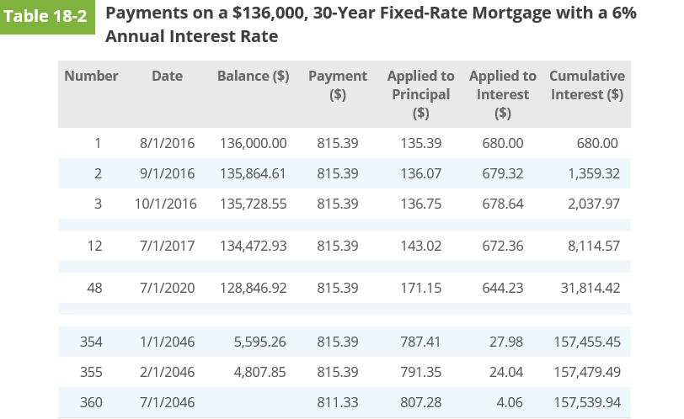
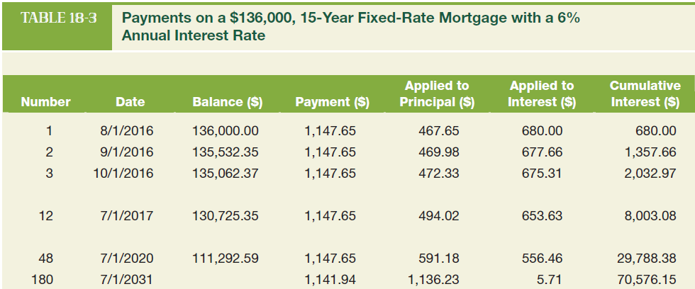
18-2g A 15-Year vs a 30-Year Mortgage
Monthly payment increases from $815
for a 30-year mortgage to $1,147.65 for a
15-year mortgage.
This higher monthly payment may be
shocking to the homebuyer but notice
how much is saved in terms of interest
paid.
By the end of the loan, the borrower
pays a total of $70,576 in interest compared
with $157,539 on the 30-year mortgage.
Also consider how much faster the principal
is paid down under the 15-year mortgage
compared with the 30-year mortgage
Money and Banking – Michael Brandl ©2017 Cengage Learning

Slide 10
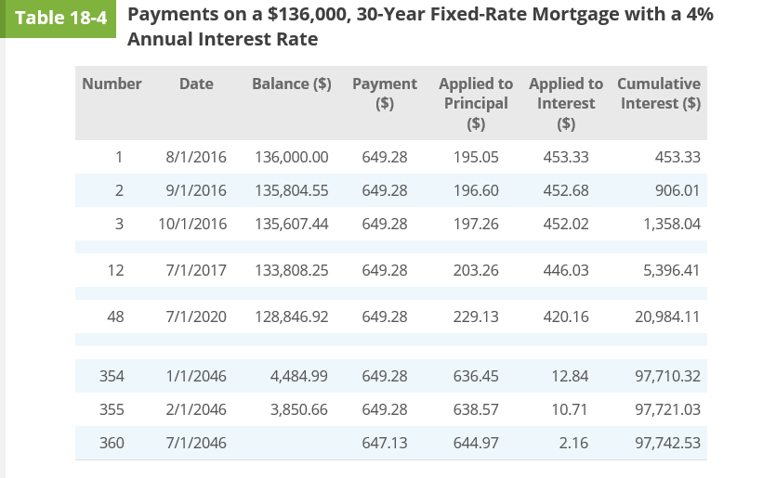
18-2g A 6% vs a 4% 30-Year Mortgage
With a 4% 30 year mortgage loan payment is now $649.28, rather than $815.
But cumulative level of interest paid much lower at $97,742.53 vs $157,539.94
By month 48 (4 years) amount paid in interest is around $21,000 vs nearly $32,000 with a 30 year mortgage
https://templates.office.com/en-us/Mortgage-Loan-Calculator-TM10000110

Slide 11
18-2h Taxes and Insurance
Lenders also often insist that insurance is paid, and also that property taxes are paid on the property. So this is often added to the cost of the mortgage.
“Escrow” account is usually used to save for property taxes and homeowner’s insurance each month via an addition to the mortgage payment
Property taxes are the main source of revenue for many local government entities including cities, counties, and school districts.
Property tax is usually calculated as a percentage of the assessed market value of the property.
The Federal Reserve estimates that homeowner’s insurance averages about $3.00 per $1,000 of the home’s purchase price.
Money and Banking – Michael Brandl ©2017 Cengage Learning

Slide 12
18-3a New types of Mortgage: Zero Down Home Mortgage
The lender provides 100% of the purchase price of the house.
Default rates on mortgages is lower when borrowers have a traditional 20%, or more, down payment
Alignment of incentives when there is “skin in the game”
Money and Banking – Michael Brandl ©2017 Cengage Learning

Slide 13
18-3b Teaser-Rate ARMs
ARM: the borrower bears the risk that interest rates may increase in the future
ARM is a desirable alternative to a traditional fixed-rate mortgage
An ARM makes sense for a buyer who plans on living in the house they are buying for only a few years – “flipping”
Teaser rate ARMs set an extremely low initial interest rate, but then after a specified period, interest rate “resets” to higher interest rate.
For example 1% in year 1-3, then 10% in year 4 onwards. Payments on $170k mortgage: Initially $547 then $1,492.
Money and Banking – Michael Brandl ©2017 Cengage Learning

Slide 14
18-3c Negative Amortization Home Mortgage
NegAms: the monthly mortgage payment paid by the borrower is less than the interest charged over the month.
At the end of the month the mortgage balance increases.
Most negative amortization mortgages allowed the negative amortization to go on only for the first few years of the mortgage
Sometimes known as “balloon mortgages”
Money and Banking – Michael Brandl ©2017 Cengage Learning

Slide 15
18-3d No Documentation Home Mortgage
The riskiest of the “new” mortgages
Did not require any verification of income or assets of the borrowers.
The potential for deception and fraud was overwhelming.
Sometimes it was the loan originator who would falsely report the borrower’s financial status to ensure that the mortgage application would be approved.
Now not permitted.
Money and Banking – Michael Brandl ©2017 Cengage Learning

Slide 16
18-4a Problems in Developing a Secondary Market for mortgages
Mortgages were usually too small for institutional investors to purchase.
Mortgages were not standardized; the mature at different times, have different interest rates, and different terms.
Mortgages are difficult for an institutional investor to analyze.
Solution! “Mortgage pass-through” using Fannie Mae
Fannie Mae (FNMA – creates secondary market) – in conservatorship
Ginnie Mae (GNMA – takes over secondary market after FNMA privatized)
Freddie Mac (FHLMC – buys conventional mortgages)
Money and Banking – Michael Brandl ©2017 Cengage Learning

Slide 17
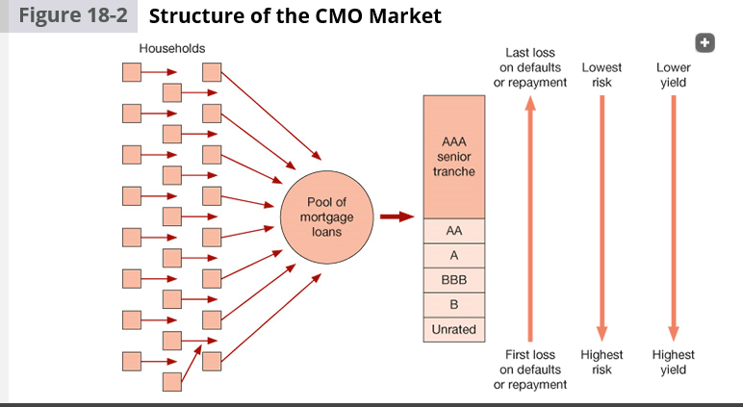
18-4b Mortgage–Backed Assets/Securities
Problem with mortgage pass through’s is “pre-payment” and “curtailment”
So new financial instruments are created:
The two most common are the modern pass-throughs and collateralized mortgage obligations (CMOs) or collateralized debt obligations (CDOs).
Most of them are issued or guaranteed by Ginnie Mae, Fannie Mae, and Freddie Mac.
Now “tranches” created for mortgages and so mortgages are stratified according to assessment of riskiness and then sold separately
Money and Banking – Michael Brandl ©2017 Cengage Learning

Slide 18
18-4c Growth of the CMO & CDO Market
How should a CMO or CDO be priced?
Markets had the ability to price bonds for a long time, but CMOs and CDOs were different: There was default risk and interest rate risk, just like bonds.
CMOs and CDOs also had prepayment risk, and because mortgages were not standardized, it became difficult to compare different mortgages to gauge correctly the different risks that existed.
https://youtu.be/csQUNX-xnBc
Money and Banking – Michael Brandl ©2017 Cengage Learning

Slide 19
18-5 The Mortgage Market, Government Policies, and the Global Financial Crisis
Misuse of the Gaussian copulas
Subprime mortgage loans
Lax underwriting standards
Misalignment of incentives
Money and Banking – Michael Brandl ©2017 Cengage Learning

