Slide 1

Chapter 8 – Central Banks

Slide 2
8-1a Evolution of the Federal Reserve
The central bank and monetary authority of the United States but significantly changed from 1913
Began as 12 Independent regional banks
Main purpose was to maintain the Gold Standard & be the lender of last resort to commercial banks
Regional Banks would lend to Commercial Banks only when Commercial Banks provided “Eligible paper” or “real bills” as collateral
= “Real bills doctrine”

Slide 3
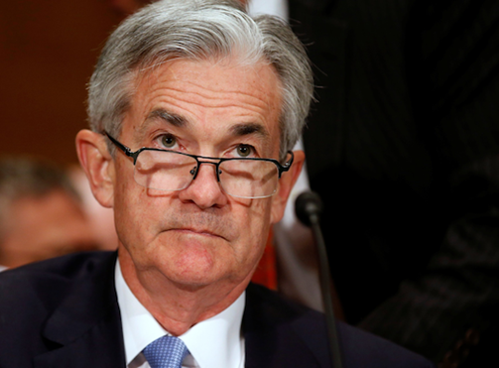
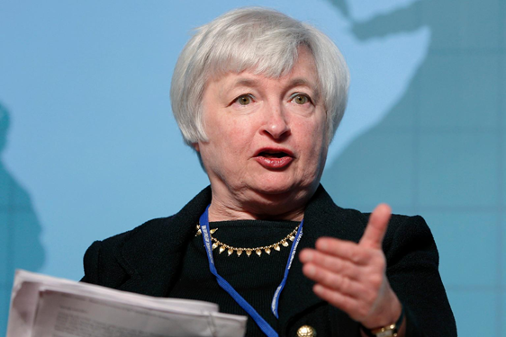
8-2a Current Structure of the FED:
The Chair
The chairperson of the board of governors
  Currently Jay Powell (formally Dr. Janet Yellen)
Appointed by The President of the United States with the confirmation of the U.S. senate (only).
Serves a 4 year renewable term

Slide 4
Duties of Chairman
Advises the president on economic policy
Testifies in Congress
Speaks for the Federal Reserve System to the media
May represent the U.S. in negotiations with foreign governments on economic matters

Slide 5
8-2b Board of Governors
Six governors appointed by the President and confirmed by the US Senate
Governors serve 14 year, non-renewable terms
Governors’ focus:
  Operation of the Fed
  Commercial Bank regulation
  Monetary Policy

Slide 6
Duties of BoG
Votes on conduct of open market operations
Sets reserve requirements
Controls the discount rate through “review and determination” process
Sets margin requirements
Sets salaries of president and officers of each Federal Reserve Bank and reviews each bank’s budget
Approves bank mergers and applications for new activities
Specifies the permissible activities of bank holding companies
Supervises the activities of foreign banks operating in the U.S.

Slide 7
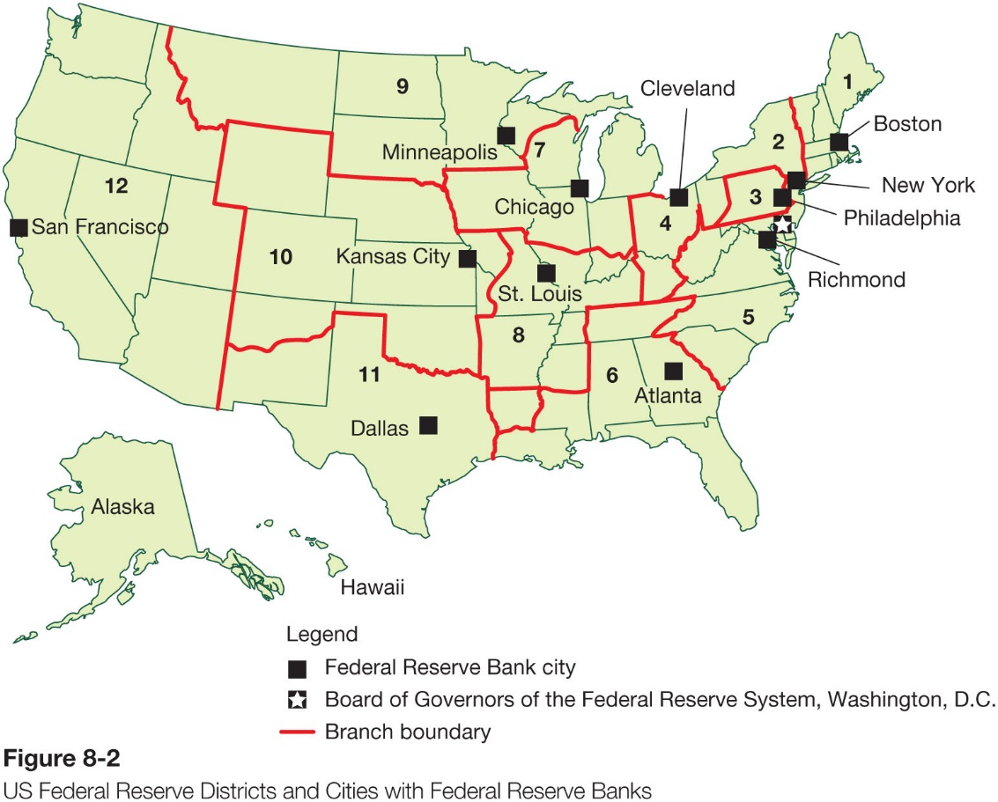
8-2c Federal Reserve District Banks

Slide 8
8-2d Federal Open Market Committee
Aids the Board of Governors on conducting monetary policy
FOMC is made up of 12 individuals
The seven member of the Board of Governors
The President of the N.Y. Federal Reserve Bank
Four of the remaining presidents of Federal Reserve Banks on a 1 year rotating basis

Slide 9
FOMC
Meets eight times a year
Consists of seven members of the Board of Governors, the president of the Federal Reserve Bank of New York and the presidents of four other Federal Reserve banks
Chairman of the Board of Governors is also chair of FOMC
Issues directives to the trading desk at the Federal Reserve Bank of New York

Slide 10
8-3a Responsibilities of the Fed
Financial market oversight: It makes periodic examinations to access bank profitability
Acting as fiscal agents: The Fed acts as the provider of financial services for the Federal Government
Consumer Protection: Writing and enforcing financial market regulations as well as implementing the consumer protection laws passed by congress

Slide 11
Responsibilities of District Banks
Clear checks
Issue new currency
Withdraw damaged currency from circulation
Administer and make discount loans to banks in their districts
Evaluate proposed mergers and applications for banks to expand their activities
Act as liaisons between the business community and the Federal Reserve System
Examine bank holding companies and state-chartered member banks
Collect data on local business conditions
Use staffs of professional economists to research topics related to the conduct of monetary policy

Slide 12
District banks and monetary policy
Directors “establish” the discount rate
Decide which banks can obtain discount loans
Directors select one commercial banker from each district to serve on the Federal Advisory Council which consults with the Board of Governors and provides information to help conduct monetary policy
Five of the 12 bank presidents have a vote in the Federal Open Market Committee (FOMC)

Slide 13
8-3b The Fed’s Balance Sheet
Offers a window to see the biggest economic crisis since the Great Depression and global financial markets.
Assets the Fed holds:
  Securities
  Repurchase Agreements
  Term Auction Credit
  Gold and Special Drawing Rights
  Coin
  Discount Loans
  Currency Outstanding
  Treasury Deposits
  As well as others

Slide 14
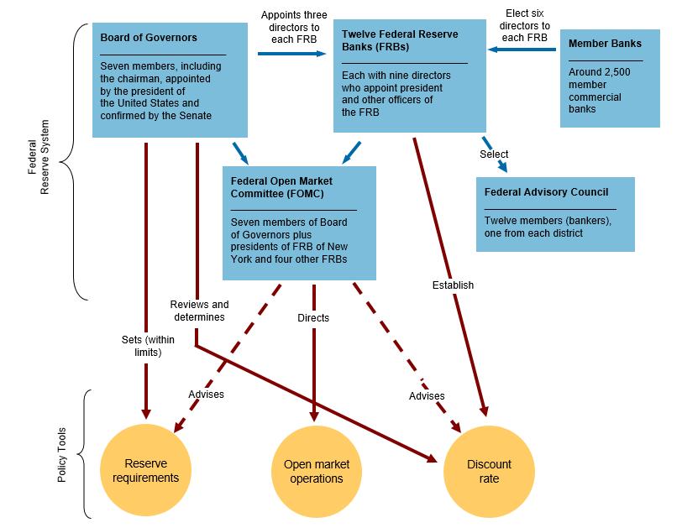
Structure of Fed
Tools of the Fed:
Reserve requirements
OMOs
Discount rate

Slide 15
8-4a Bank of Japan
Founded in 1882
1998 The Bank of Japan Act - became an independent central bank
Responsibilities :
  Issue bank notes
  Financial market stability
  Monetary Policy

Slide 16
8-5a European Central Bank (ECB)
Created in 1998
Euro launched on January 1, 1999
Headquarters in Frankfurt, Germany
2014 Euro Zone was created with 18 member countries

Slide 17
8-5b Bank of Canada
Formed in 1867
Bank of Montreal acted as the government’s banker
Canadian banks would expand and contract their lending with the rise and fall of global economic activity

Slide 18
Summary
History of Fed
Current Fed setup
Bank of Japan
ECB
Bank of Canada

