Slide 1

Chapter 7 - Banks and Money

Slide 2
7-1a Asymmetric Information
Asymmetric Information in markets can lead to inefficient outcomes
2 types:
  Adverse Selection – before the transaction
  Moral hazard – after the transaction
The scarce resources of society can be wasted or misallocated
Economists ask, how can it be corrected?

Slide 3
7-2a Overcoming Adverse Selection in Financial Markets
Information Collection
  Associated costs then give rise to free-rider Problem
Government-Required Disclosures
  Requires regulation
Screening

Slide 4
7-3a Moral Hazard in Corporate Governance
Shareholders and the management team change the management team’s behavior because of the incentives. With the employment contract, now the management team has a lot to lose if things went bad and not much to gain if things went well.
Principle–agent problem: The problem of motivating one party (the agent – usually the management or workers) who has been hired by another party (the principle – the owners or shareholders) to act in the best interests of the hiring party.

Slide 5
7-3b Moral Hazard in Financial Markets
Moral Hazard is a major problem in financial markets.
Consider the following:
  Moral Hazard in Insurance: e.g. now I’m insured, I treat risk less seriously
  Moral Hazard in Lending: e.g. you lend me money for x, but I might really want to spend it on y
  Moral Hazard in Debt & Equity Markets: e.g. companies issue debt or equity saying that want to do x, but not revealing true intent or hiding some info to make offering successful

Slide 6
7-3c Overcoming the Moral Hazard Problems in Financial Markets
Here are some of the ways in which financial markets attempt to overcome the moral hazard problem:
  Deductible & Adjustable Premiums – only pay to those who have major verifiable losses
  Restrictive Covenants – only cover very narrow events
  Compensating Balances – requiring bad credit to have credit card but with a balance already on it
  Corporate Board of Directors – making sure Board is aligned with objectives of shareholders

Slide 7
7-4a Provide Liquidity
Liquidity: the ease and expense at which one asset can be converted into another asset.
Liquidity spectrum – from illiquid to liquid
Demand deposits are very liquid; that is, converting a demand deposit into cash is easy and inexpensive.
On the other hand, an automobile is relatively illiquid; that is, it takes a more time and some hassle to sell a car or to convert the car into another asset: cash.
Most illiquid asset is probably a piece of art

Slide 8
7-4b Reduce Transaction Costs
One of the biggest transaction costs in financial transactions are search costs.
Search costs in financial markets are the implicit and explicit costs involved in savers and borrowers looking for each other.
To understand why search costs are important, think of what a hassle it would be if you were a saver and there were no banks.

Slide 9
7-4c Block Lending
Another mismatch between savers and borrowers: the size of the desired transactions
Diversification: reducing risk by holding a variety of assets
  Not “putting all your eggs in one basket”
Diversification of assets of different types and different issuers e.g. stocks and bonds vs real estate

Slide 10
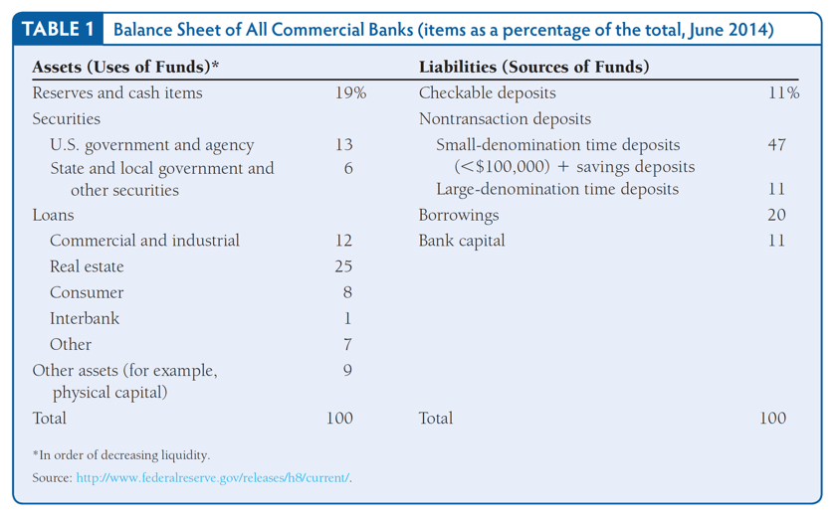
Banking system

Slide 11
7-5a Day 1 at Anchor Bank
Assets = Liabilities + Net Worth ( = value of shares)
How much should the bank lend out and how much should it hold in reserves in order to meet the cash needs of its depositors
Banks are told by one of their regulators what portion of deposits they must hold in the form of reserves. That is, the banks are told their required reserve ratio.
Reserves = money that is not lent out (currency + vault cash + balance held with the Fed)
Total reserves = Required reserves + Excess reserves

Slide 12
7-5b Day 2 at Anchor Bank
If the level of demand deposits in the system increases, there is an increase in the money supply.
This is exactly what happens when a bank writes a loan and creates a new demand deposit for the loan customer.
This, it turns out, is how modern banking systems create money: through the banking system.

Slide 13
7-6a Banks Create & Destroy Money
The important thing to remember is that a large portion of our money supply is created through the banking system.
It is when banks lend money that money is created, and it is through the banking system that the money supply is increased or decreased.
Thus, banks play an important role in the creation and reduction of the money supply.

Slide 14
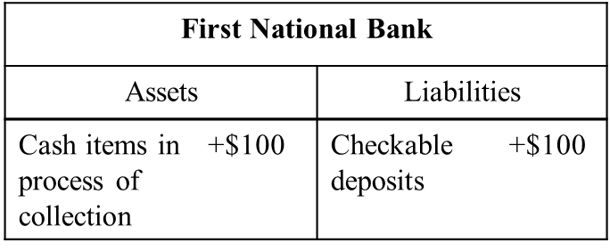
Basic banking
Deposit of cash into a checking account
Deposit of a check into a checking account
Anchor Bank |  |  |  | Anchor Bank
Assets |  | Liabilities |  | Assets |  | Liabilities
Vault Cash | +$100 | Checkable deposits | +$100 | Reserves | +$100 | Checkable deposits | +$100

Slide 15
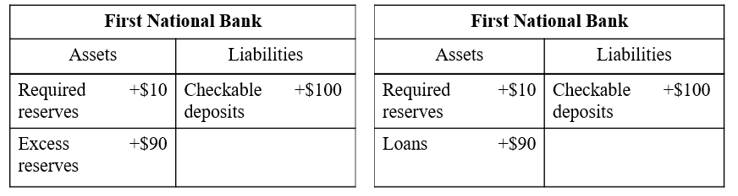
How banks lend
Assume a required reserve ratio of 10%
If this lending is a 30 year mortgage for example, the bank borrows short and lends long

Slide 16

Simple deposit multiplier process
If money lent out is re-deposited in another bank and then some of that deposit lent out again, then this will cascade through the financial system increasing the money supply as:
  M1 = C + D
Simple deposit multiplier is (assuming excess reserves = 0):
Of course increased lending also means that supply of loanable funds increases (which does what to interest rates?)

Slide 17
7-6b Banks are Subject to Bank Runs
When all (or a large number) of the depositors of a bank want their money back at once, this is called a bank run.
How do you make people believe the banking system is safe?
Give depositors confidence that their money was “safe”
  Architecture
  Deposit Insurance

Slide 18
7-6c If Banks Don’t Lend
Credit Crunch: When private borrowers find borrowing from banks difficult.
Credit crunches can come about because banks become concerned about the future of the overall economy or because banks are already experiencing a decline in the market value of their assets.

Slide 19
7-6D If There is a Lack of Banks
If there are no banks, lending does not take place, the money supply does not increase, and, most important, the level of economic activity does not increase.
If there is a lack of economic activity, unemployment may increase and businesses may fail.
In short, the entire economic system may stagnate.

Slide 20
7-6e Problems with the Simple Deposit Multiplier
The simple deposit multiplier makes some simplifying assumptions that make it easier to use and understand, but these assumptions come at the cost of making the simple deposit multiplier unrealistic.
Zero Excess Reserves
Nonbank Public Holding Cash
The problem is that this large increase in cash holdings means that the deposit multiplier is shrinking, and thus the money supply can cease to increase and may even decrease.

Slide 21
Summary
Asymmetric info
Adverse selection
Moral hazard
Role of banks in the economy
Liquidity
Bank runs
Diversification
Reserves
Simple deposit multiplier model
Problems with the simple deposit multiplier model

