Slide 1

Chapter 5 - Financial Markets Through Time

Slide 2
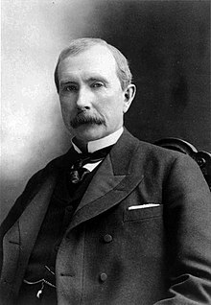
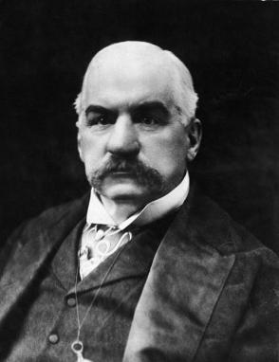
5-1a The Early Twentieth Century
(“The gilded age”)
Change came about as American business evolved.
The U.S. business sector was dominated by the expansions of trusts.
Trusts are horizontally integrated ownership (combining similar goods) Trusts; agreements that created monopolies.
  e.g. J.Pierpont Morgan (Banking), John D. Rockefeller, Andrew Carnegie (Steel)
  http://www.pbs.org/wgbh/americanexperience/features/gilded-age-jp-morgan-financier/
  http://www.pbs.org/wgbh/americanexperience/features/gilded-age-andrew-carnegie-man-steel/
Led to incredible wealth concentrated on a few select families – which caused a public outcry and an “anti-trust” populist movement
American corporations started to move away from trust dominated markets
Frederick Taylor, “scientific management” supported idea of professional management. Also publically held companies encouraged by Roosevelt. U.S. output increased significantly, causing the number of workers increased.

Slide 3
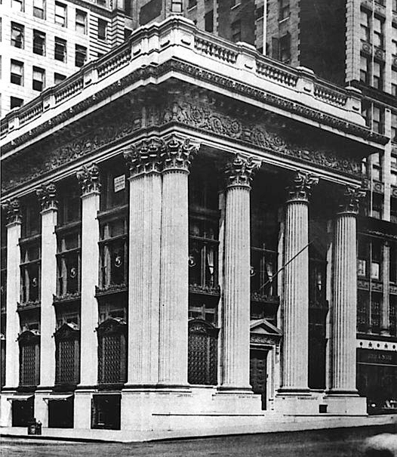
5-1b The Panic of 1907
National Banking Era (1863-1913) The U.S. did not have a central bank. Banks were allowed to issue their own currency
Almost all commercial banks were “local” and regulated on a state level. Trust banks were
Triggered by wild speculation in the stock market; loose lending by banks (A lack of effective oversight of financial markets)
Market cornering schemes rife. One such scheme caused a bank that held stock in a copper scheme (Knickerbocker Bank)
J. Pierpont Morgan ended the panic of 1907 by liquidating the Knickerbocker and by underwriting issuance of bonds by NYC to support the NY clearing house (which was owned by the City)
Clear signal that the US financial system was inherently unstable
Money and Banking – Michael Brandl ©2017 Cengage Learning

Slide 4
5-2a Early Structure of the Federal Reserve
Congress envisioned a “lender of last resort” to the banking system.
Be there for the benefit of banks; Congress created a quasi-government agency --- something created by the federal government but not part of the government.
Commercial banks were required to buy shares to raise capital to begin operations.
President Wilson -12 regional banks, whose policies are coordinated by the Fed’s Board of Governors
And so the Fed was born (1913)
Money and Banking – Michael Brandl ©2017 Cengage Learning

Slide 5
5-2a Early Structure of the Federal Reserve
(cont’d)
The Federal Reserve - No clear division of power.
District banks setting their own interest rates and lending policies.
1914 Benjamin Strong, Jr. appointed the first president of Federal Reserve Bank of New York.
1923 Open Market Investment Committee was created. Goal - centralize the making of monetary policy.
Strong’s vision; a central bank headquartered in the center of the nation’s financial market: New York.
Money and Banking – Michael Brandl ©2017 Cengage Learning

Slide 6
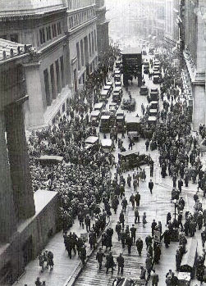
5-2b Financial Markets During the Great Depression
September 3, 1929 – stock market hits an all-time high
Roger Babson, writes “Sooner or later a crash is coming, and it may be terrific”- Stock speculators receive margin calls.
Price of shares bought on credit was falling, cash would be needed or face the loss of the stocks held. “Margin calls” were not being met and thus forcing investors to sell their shares.
Markets react to lower prices causing market selling. Panic selling had set in.

Slide 7
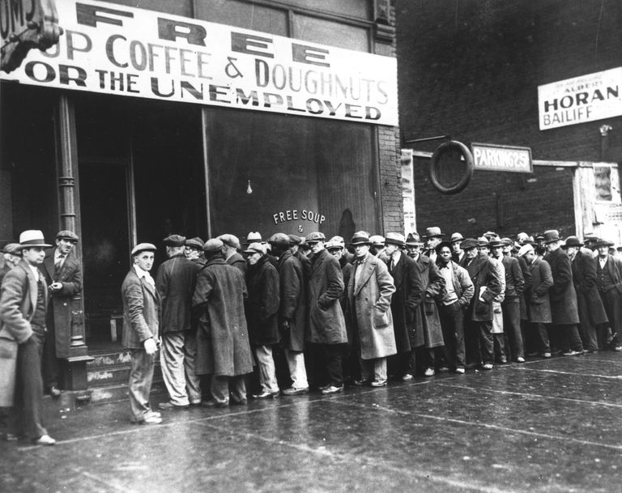
Great depression
Burgess Riefler doctrine – idea that if interest rates low, then plenty of liquidity in the system. If interest rates high, not a lot of liquidity in the system
In Great depression, Fed thought that as rates were low, plenty of liquidity, so they were not worried about lack of central bank loans. Problem was that these loans had to be backed up with commercial loans, and no commercial loans being given, so commercial banks could not borrow from the Fed.
The general lack of demand caused companies to cut their inventory and workers, and to slash prices. Deflation was the result.
Real interest rates: 1% nominal rate, -3% inflation = 4% real rate.
So now generally agreed that Fed policies made depression worse.

Slide 8
5-3a Preparing for War
1940- Walter Reuther, President (UAW) utilizes unused production capacity to produce 500 airplanes a day for US military.
1941- Roosevelt signs the Lend-Lease Act, provide military and economic assistance to countries viewed as” vital to US defense. Only way UK survives during German blockade after Dunkirk
US exports $250 million on its way to $460m of Goods and Services due to the LL Act.
US ramps up military output. Government takes control of both labor market, as well as wage and price control and capital markets to finance the war. Essentially a “centrally planned” economy.
Money and Banking – Michael Brandl ©2017 Cengage Learning

Slide 9
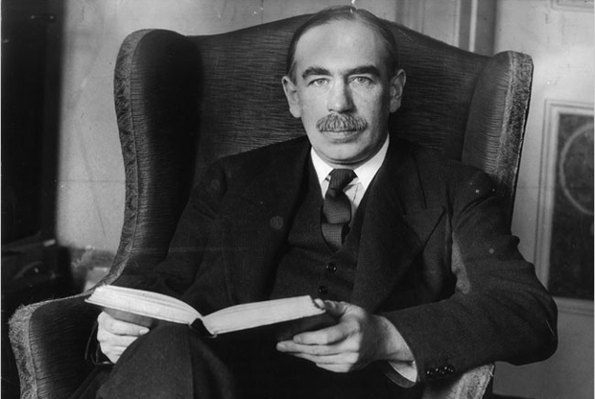
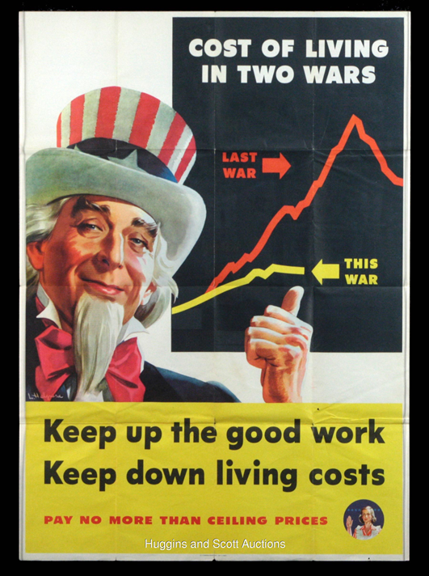
5-3b Funding the War Effort
John Maynard Keynes author of “How to Pay for the War”. Government run budget deficits by borrowing from the public and financial system.
Rationing of necessities. High Progressive income taxes. Price and wage controls.
1940-1946 Government spending increases, 75% being used for military expenditures.
Debt covering; Government sells government bonds.
War bonds (movie: “Flags of Our Fathers”)
Money and Banking – Michael Brandl ©2017 Cengage Learning

Slide 10
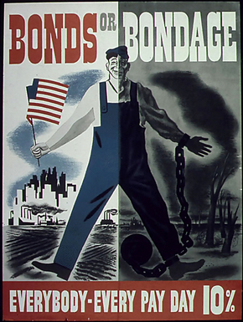
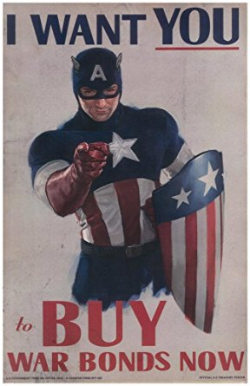
5-3c Controlling Inflation During the War
War bonds: used to fund government’s purchases. Key in keeping down inflation. Consumer goods become scarce; diverted for the war effort. Many fear prices would increase dramatically.
Compounding this fear, employment increase needed for war. The US military increases dramatically.
American men and women were needed in factories to produce military equipment. Cost of living up 62% due to increased earning power.
Government rationing – helps restrict consumption and thus inflation. Rationing coupon – issued by government, helped retard household spending.
Money and Banking – Michael Brandl ©2017 Cengage Learning

Slide 11
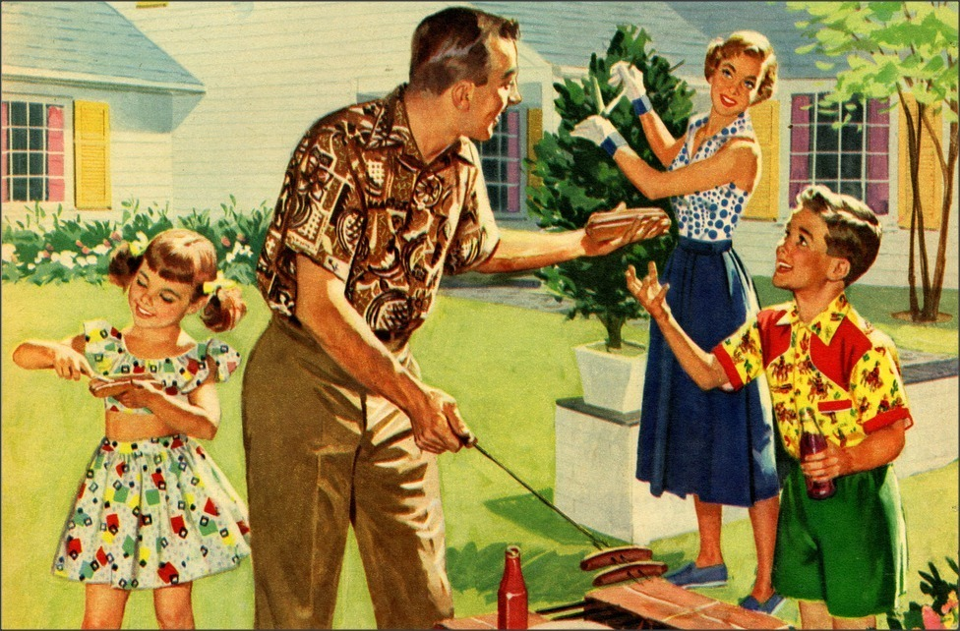
5-4a Funding the American
Dream
Savings and Loans – new type of financial institution established to encourage saving and lending for housing
FHA (Federal Housing Association) formed to insure mortgage lenders against losses from mortgage defaults
Fannie Mae established in 1938 to underwrite mortgages so that lenders will issue 30 year mortgages. Prior to this, commercial lenders will only do 2 year loans that had to be rolled over.
Money and Banking – Michael Brandl ©2017 Cengage Learning

Slide 12
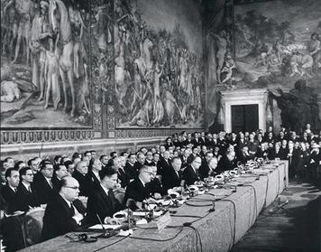
5-4b Push for European Economic and Financial Integration
Leaders of western Europe desire to create a “United States of Europe”. United Europe; a good idea.
Europe was divided in half; Western Europe – democracies leaning towards market-based economies. Eastern Europe, Soviet influence focused on a centrally planned economy.
The Treaty of Versailles ended WWI. Germany faces very high rates of inflation during the 1920s
Western nations realize, rebuild and trade leading the way, Germany and Italy are welcomed into United Europe. Trade Barriers between member nations are lifted.
Treaty of Rome (1957) sees the formation of the EEC (which has now morphed into the EU)

Slide 13
5-5a The Rise of Stagflation
1970s sees growing unemployment, increasing rates of inflation causing the economy to stagnate.
As the economy expanded, increased competition lead to higher wages. Higher labor costs get passed on to consumers, causing higher market prices.
Stagflation: economy was experiencing growing inflation and unemployment at THE SAME TIME.
Money and Banking – Michael Brandl ©2017 Cengage Learning

Slide 14
5-5b Paul Volcker
1979 - Jimmy Carter announced the appointment of new Federal Reserve Chairman: Paul Volcker.
Volcker had been serving as president of the Federal Reserve Bank of New York and had a long history of public service
Federal Reserve should concentrate on growth rate of the money supply. Volcker contended - inflation under control was to reduce the growth rate of the money supply.
Volcker took over as the Federal Reserve chair on August 6, 1979
Money and Banking – Michael Brandl ©2017 Cengage Learning

Slide 15
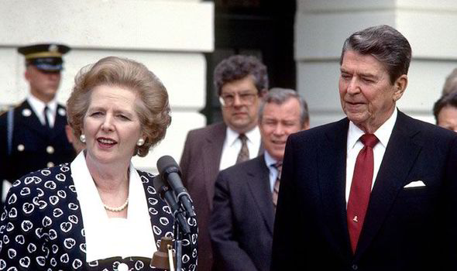
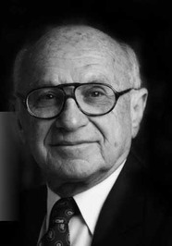
5-5c Reagan and Thatcher
Their economic policies focused on long-term issues: Growing the economy, controlling inflation, and creating economic opportunities.
1981-82: the worst recession since the Great Depression
Very high interest rates to control money supply – “monetarism” which was proposed by Milton Friedman
Tight money policy helped the economy rid inflation.
Easier monetary policy helped the economy start to grow and expand without inflation.

Slide 16
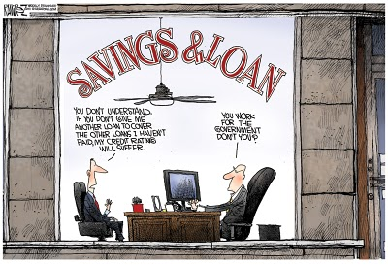
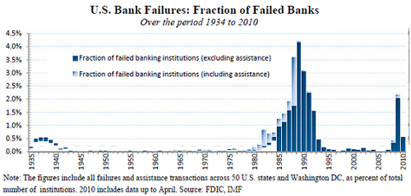
5-6a The Savings & Loan Crisis
Savings & Loans: Major player in the housing boom; post-WWII era.
Inflation began to rise, causing interest rates to follow. S&L began losing deposits to Money Market Mutual Funds.
Regulation Q law: Capped interest rates that S&L could pay.
DIDMCA (Depository Institution Deregulation and Monetary Control Act): Allowed S&L to pay market interest rate on deposits.
Garn-St. Germain Act of 1982 – Reduce the amount of regulation over the Savings & Loan or thrift industry.
Led to reckless lending…
Money and Banking – Michael Brandl ©2017 Cengage Learning

Slide 17
5-6b Leverage Buyouts & Junk Bonds
1980s - A push for deregulation of markets; (LBO) craze. [“Wall Street” movie]
LBO – acquisition of a public or private company; buyout is financed mostly by debt (called Leverage).
Assets are used as collateral for the debt that is issued to buy the acquired company’s outstanding stock.
1980s saw LBOs increase due to the deregulation of financial markets and the relaxation of anti trust and securities laws.
Money and Banking – Michael Brandl ©2017 Cengage Learning

Slide 18
Summary
The Gilded age and decline of the Trust
Bank panic of 1907
Founding of the Fed
Stockmarket crash of 1929
Great depression
Funding the American dream
S&L crisis
Monetarism and inflation
LBOs and Junk bonds

