Slide 1

Chapter 4 – Interest Rates in More Detail

Slide 2
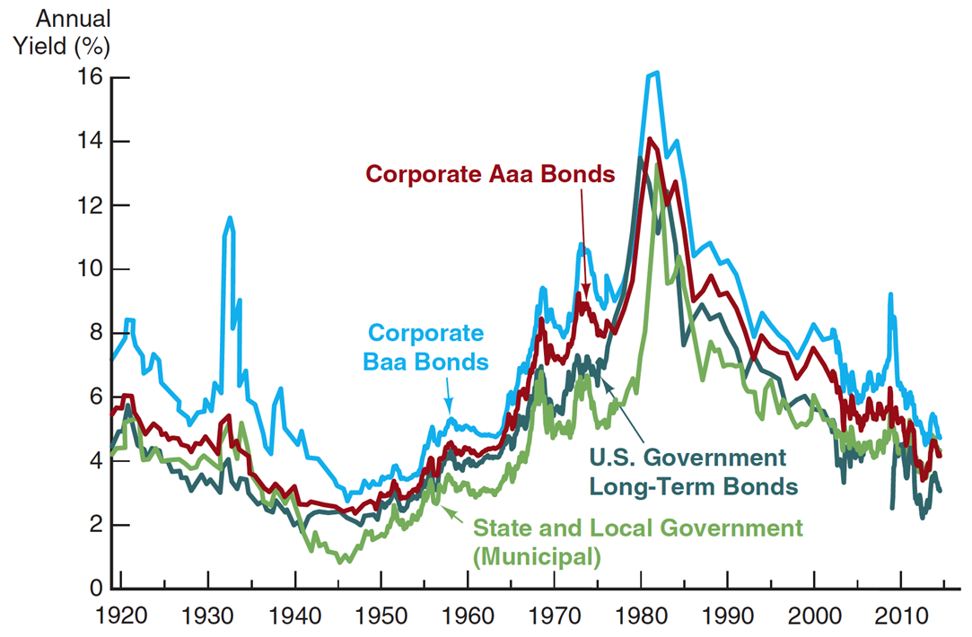
Interest rates

Slide 3
4-1a Default Risk
Agreement between two parties:
  The buyer of the bond agrees to lend some money to the bond issuer
  The issuer of the bond agrees to pay over time interest payments as well as face value of the bond
The greater the default risk, the more the lender is going to be compensated for lending funds

Slide 4
4-1a Default risk: (continued)
Default or failure can occur under direct control of the borrower due to the following:
  A firm may expand too quickly
  A household living beyond their means
Economy may enter into recession or a natural disaster

Slide 5
4-1b Calculating DRP (default risk premium)
Predicting the future – determining the probability that the borrower will not pay as promised.
A very difficult task – Look for shortcuts
Borrower’s bond rating: dangerous to assume accurate rating
Bond rating is not an accurate measure of default risk

Slide 6
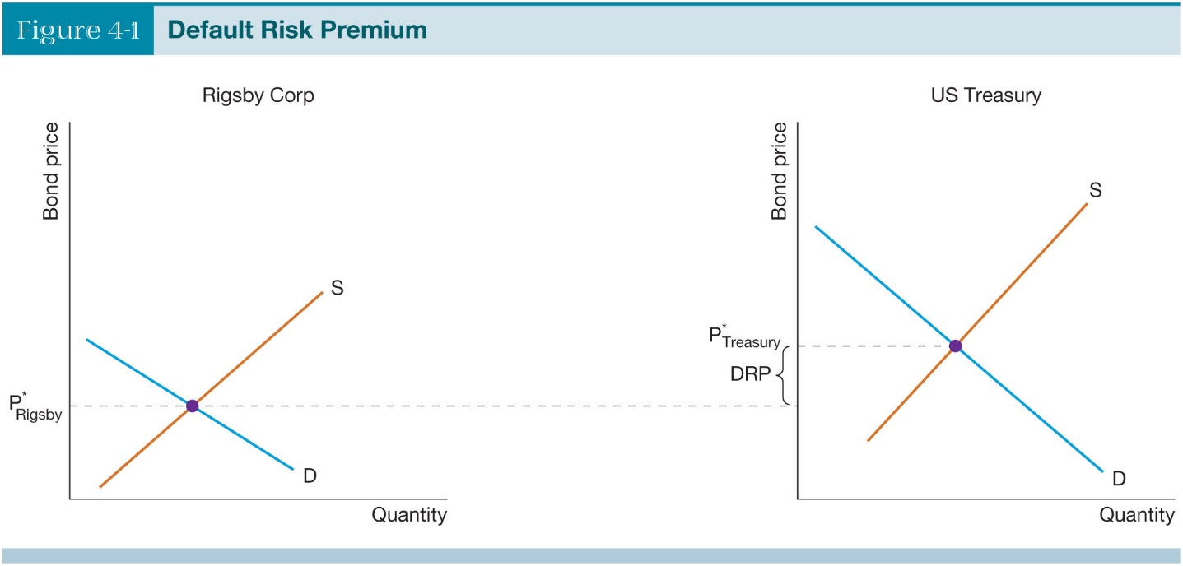
4-1c Comparing default risk of different financial instruments
Corporate Bond vs. US Treasury Securities – assume exactly the same maturity date and currency
Inverse Relationship – Bond Price and Interest (Yield)
Supply and Demand analysis useful to examine DRP

Slide 7
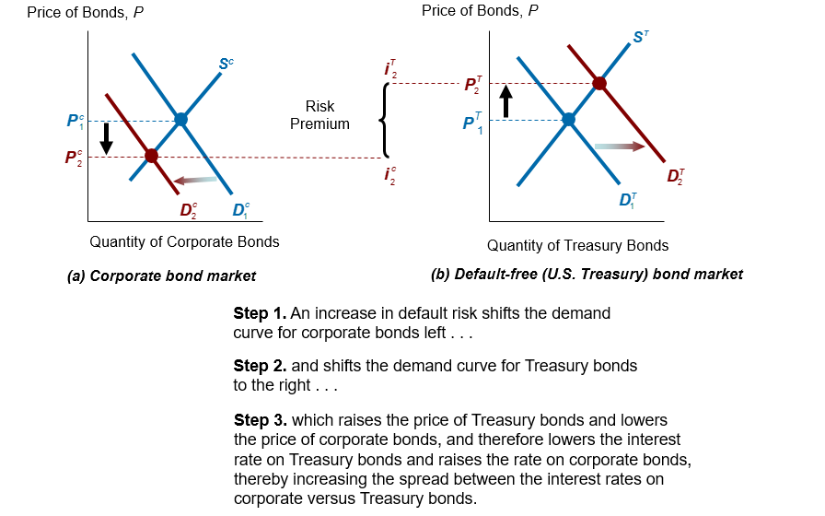
Default risk steps

Slide 8
4-2a Why we worry about inflation
Inflation: the continuous increase in the general level of prices
Price increase is caused by an increased rate of inflation
Consumers who depend on wages and salaries for consumption see their consumption fall.
Wealthy do not depend on wages and salaries, they depend on assets and investments

Slide 9
4-2b Real vs. Nominal Interest Rates
Real Interest Rate = Nominal Interest Rate – Inflation rate
The interest rate that has been adjusted for inflation (real interest rate)
Nominal interest rate, expressed in terms of annual amounts currently charged for interest and not adjusted for inflation.

Slide 10

4-2c Ex Post vs. Ex Ante
Looking to the future OR Looking at the past

Slide 11
4-3a Before- & After-Tax Returns
Wages & Salaries are “labor income”
Interest earned from holding a bond is income that is subject to income tax
Progressive Income Tax: the higher the level of income, the higher the marginal tax rate paid

Slide 12
4-3b Municipal Bonds & Taxes
Local municipalities and government agencies need to raise capital
Interest paid on Muni-bonds is not currently subject to federal income tax
2 bonds – a corporate bond and a muni bond: they are exactly the same except for the yields.
J Doe, currently in a 28% tax bracket. The interest earned on the corporate bond is 28% taxable income vs. 0 tax on the muni bond; which is more desirable?

Slide 13
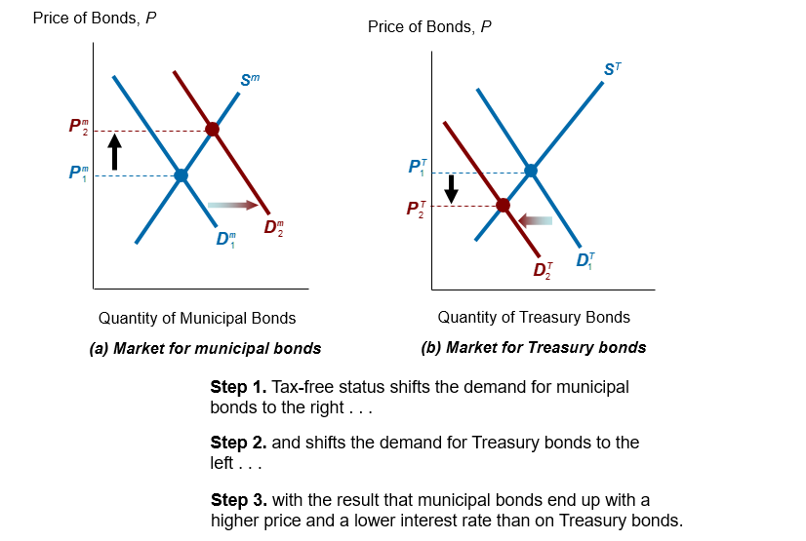
Muni bonds vs Treasuries - steps

Slide 14
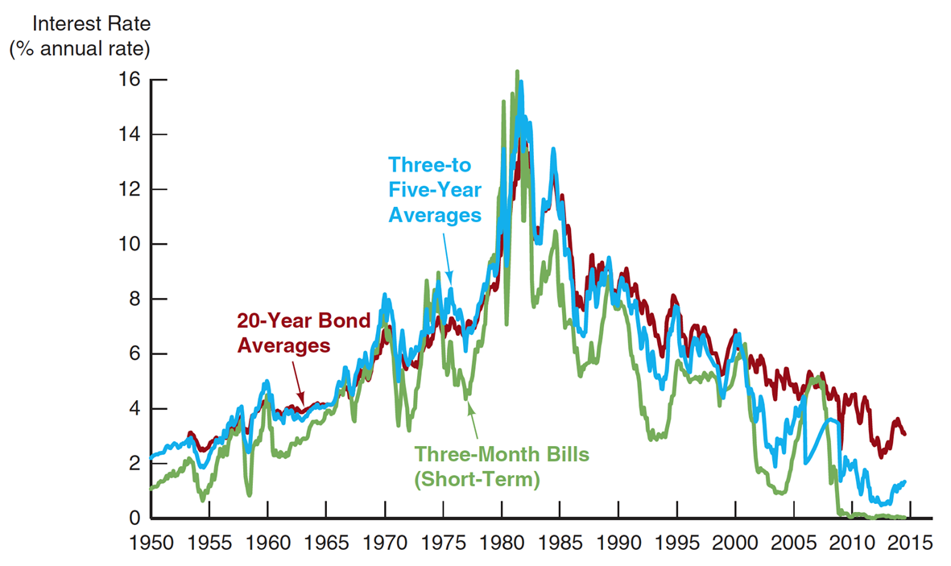
Yields for bonds with different maturities

Slide 15
4-4a Yield Curve Graph
Purchasing Bonds
“Term structure of interest rates”
Bonds or debt instruments that have different terms or lengths of maturity tend to have different interest rates.
Each point on the curve shows length to maturity, it is not a measurement of time as in what interest rates will be in the future.

Slide 16
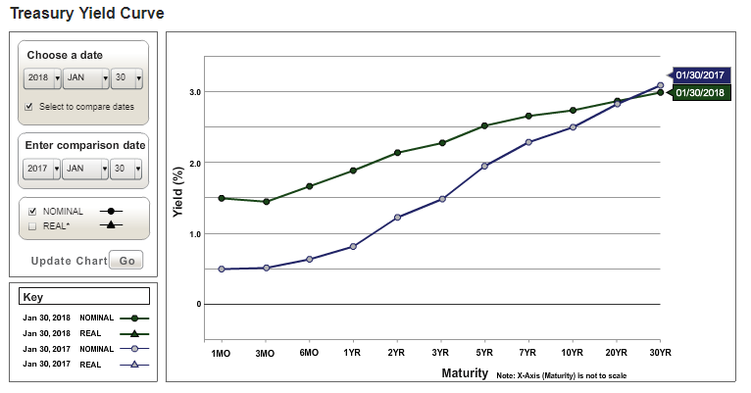
Treasury Yield Curve

Slide 17
4-4c Pure Expectations Theory
States the yields on long-term bonds are made up of the market expectations of what short-term yields will be in the future.
If we know the 1 year bond rate today, and the 2year bond rate today we can solve the expected rate.
An upward sloping yield curve tells us the market thinks short term rates are going to be higher in the future than what they currently are
A downward sloping curve (inverted) suggests short-term interest rates will be lower than today

Slide 18
4-4e Segmented Market Theory
Argues that the market for short-term bonds is completely different from the market for long-term bonds and that these two markets are different from the medium-term bonds market
Proponents of this theory point out that the issuers of short-term bonds are different from the issuers of long-term bonds.

Slide 19
4-4d Term/Liquidity Premium Theory
Short-term bonds are more liquid. A bondholder can get money out of a short-term bond more quickly and easily than from a long-term bond
Longer-term bonds have a higher yield than shorter-term bonds.
Yield curves generally slopes upward because of the term premium that has to be paid to entice bond buyers to buy longer-term bonds.

Slide 20
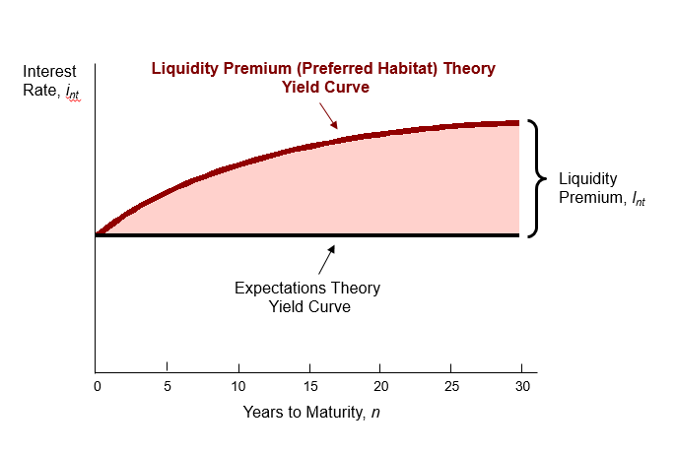
Liquidity Premium theory
Explains why yield curve is upwardly sloped much more frequently than it is downwardly sloped

Slide 21
4-5a Inverted Yield Curve
Inverted yield curve occurs when longer-term interest rates are lower than shorter-term interest rates.
From the perspective of pure expectations theory, short-term interest rates will be lower in the future than they are today
From the perspective of segmented market theory, a contractionary monetary policy pushes up short-term interest rates, creating an inverted yield curve.

Slide 22
4-5b Steep Yield Curve
Pure Expectation Theory suggests: A steep yield curve suggests that short-term interest rates will be significantly higher in the future than what they are currently. There are two main reasons why this might occur:
  (a) High inflation rates in the future.
  (b) Faster economic growth.
Term premium theory suggests: Savers currently have a better use for funds
  Savers worry about the future

Slide 23

4-5c Flat Yield Curve
Pure expectations theory says a flat yield curve suggests short-term interest rates in the future will be where they are well into the future.
Term premium theory says a flat yield curve suggests that the term premium has gone to zero. Savers are indifferent to what kind of bonds they hold.
Segmented market theory says a flat yield suggests things are going on in many markets at the same time.

Slide 24
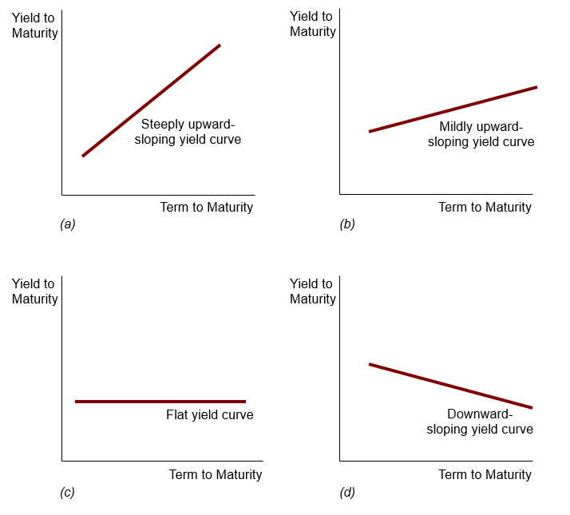
Yield curve slopes
We need to add in a liquidity premium to interpret these properly.

Slide 25
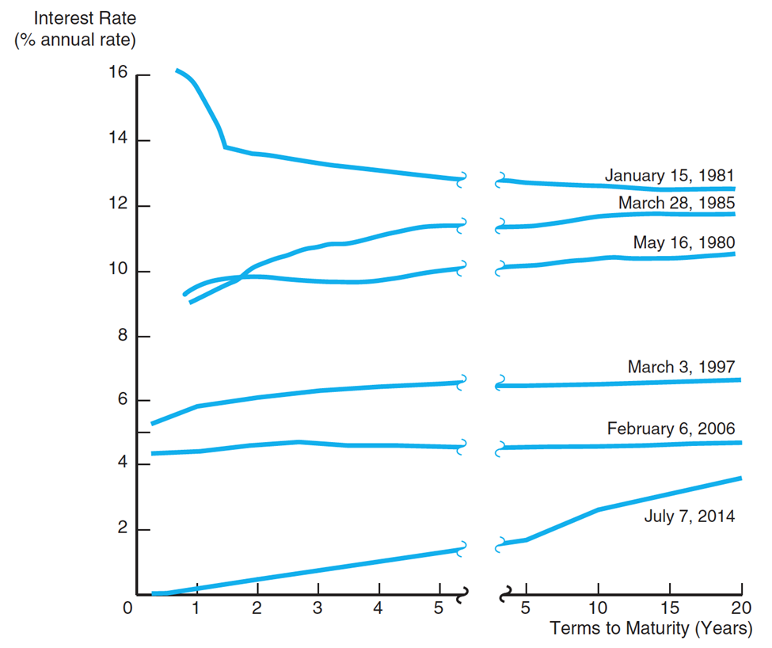
Some examples
Recessions are (nearly) always preceded by an inverted yield curve

Slide 26
Summary
Default risk
Tax treatment of bonds
Yield curve
Expectations theory of yield curve
Preferred habitat theory
Liquidity premium theory
Usefulness of yield curve

