Slide 1
Chapter 3 – Bonds and Loanable Funds

Slide 2
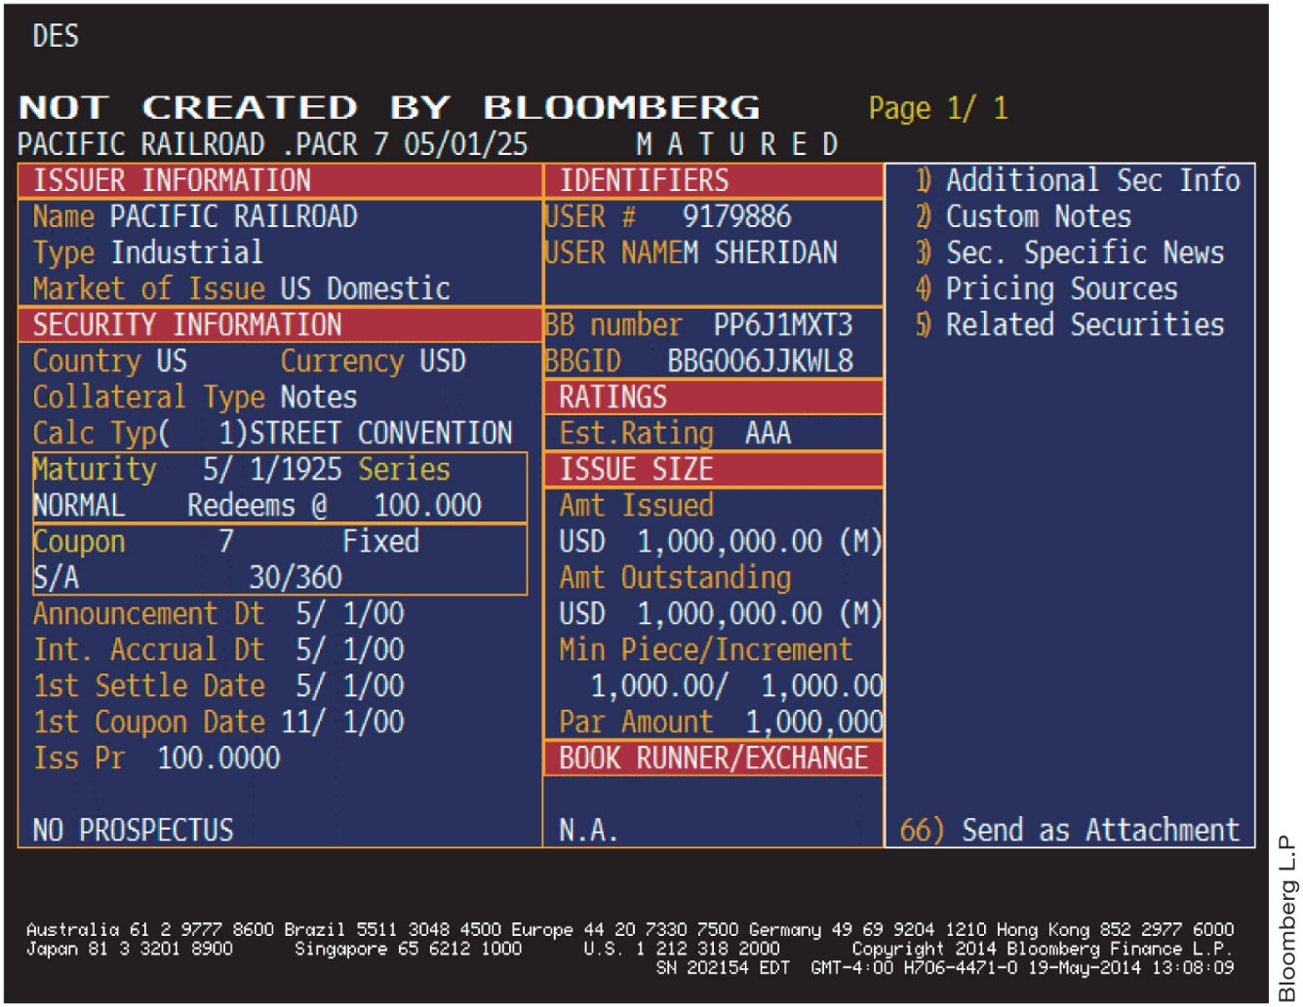
3-1a Bonds Defined
Financial Markets: A place where savers and borrowers come together
History: During the old days corporations
or governments who issued bonds
They would print a physical promise to
repay a bond
Today: Most bonds are issued
electronically

Slide 3
Bond terminology
Maturity = time to redemption
Redemption = date at which IOU is repaid (Capital)
Face value = amount that bond will be redeemed for
Coupon rate = % of face value that lenders are paid to hold bond
Yield = coupon payment + change in price of bond to face value
Default = inability to make coupon payments
Sovereign bond = bond issued by a government
Corporate bond = bond issued by a private corporation

Slide 4
3-1a Bonds Defined (continued)
The Pacific Railroad bond was used to fund the construction of the Western Pacific Railroad.
Historic event: The Pacific Railroad bond was used to raise money to fund the construction of the Western Pacific Railroad.
Coupons – the owner of the bond would clip off and send in each May and November and receive in return their interest payment: $35.00 (2x’s a year)

Slide 5
3-2 Bond Prices and Yields
Bond – A promise to repay (IOU), with interest that is issued by corporations, government agencies and governments
Issuer – receives face value and promises to pay that amount at maturity
Issuer – pays interest at the coupon rate to the holder of the bond
Interest rates and bond prices are inversely related. When the interest rate increases, bond prices fall; when the interest rate falls, bond prices rise.

Slide 6
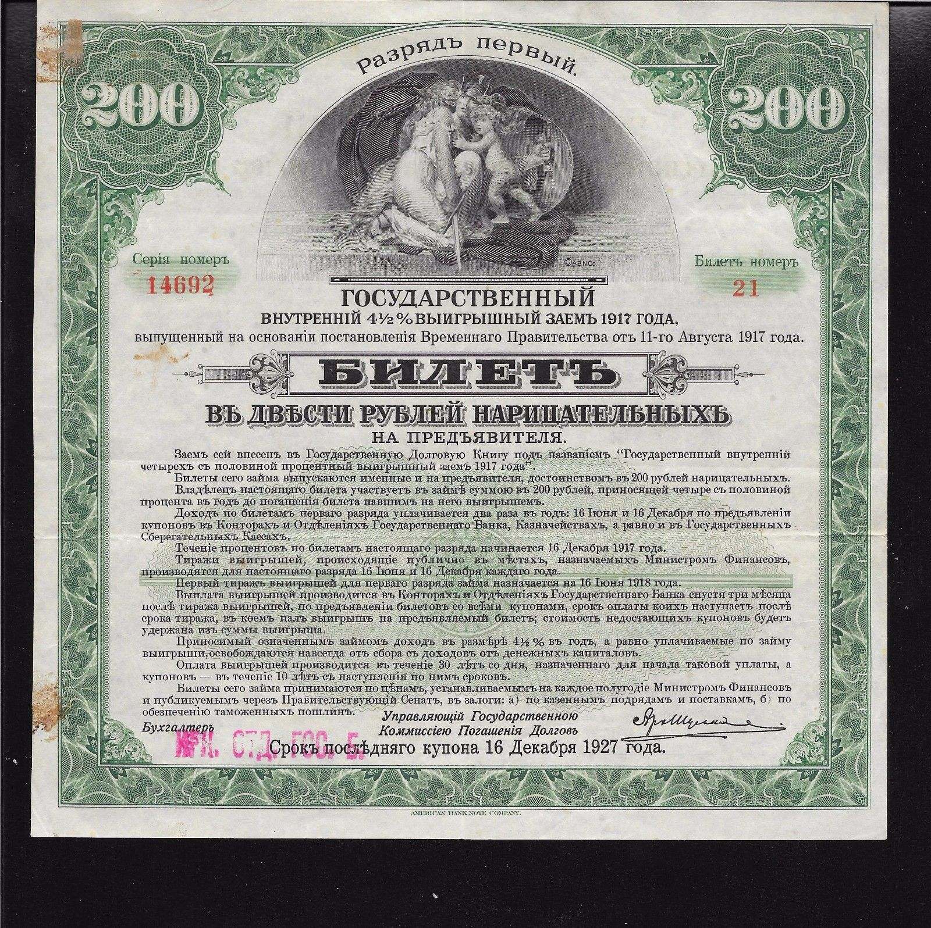
Media
https://www.npr.org/2015/07/01/419240752/how-mississippi-defaulted-on-7-million-worth-of-bonds-in-1841
Example of Russian bond

Slide 7

3-2a Prices of Bonds
Pbond: Present Value of the cash flow the bond owner can expect to receive over the life of the bond.
Cash Flows represent interest payments based on
  Coupon rate
  Principal or face value of bond at maturity
  Solve for k, where k = bond yield

Slide 8
3-2a Price of Bonds –(continued)
  k= interest rate per period
  n= # of periods
Please note: Par = When market price of a bond equals the face value of the bond
Par occurs when coupon rate = yield

Slide 9
3-3a The Supply of Bonds
Supply Curve: Direct relationship between Price and Quantity Supplied.
The upward slope of the curve reflects the law of supply – suppliers offer more of a good, service, or resource for sale as its price rises.

Slide 10
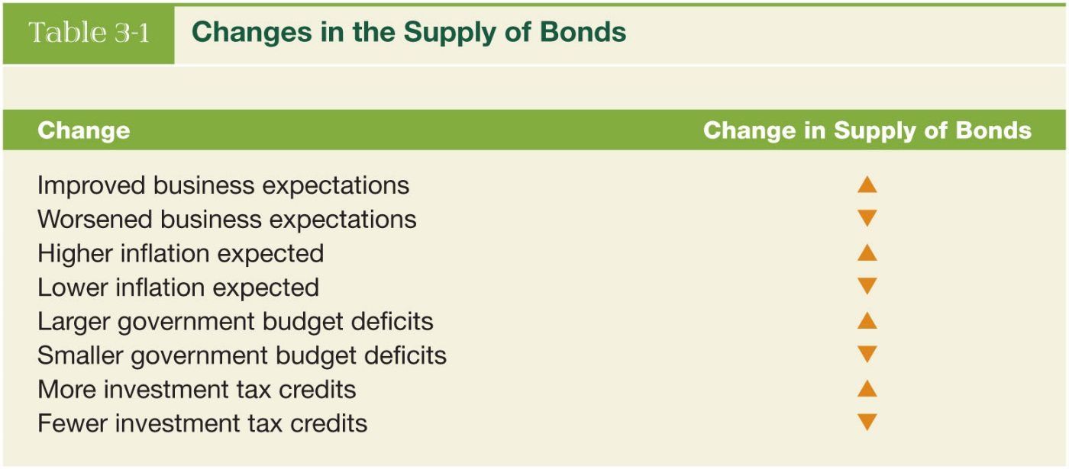
3-3b Changes in the Supply of Bonds
Change in Supply vs. Change in Quantity Supplied
A change in supply means a SHIFT of the Curve
A change in quantity supplied means a movement from one point to another on a fixed supply curve
The cause of such a movement is a change in PRICE of a specific product

Slide 11
3-3c The Demand for Bonds
Price is a quantity relationship from the buyer’s perspective
As price of bonds decreases, quantity of demand increases

Slide 12
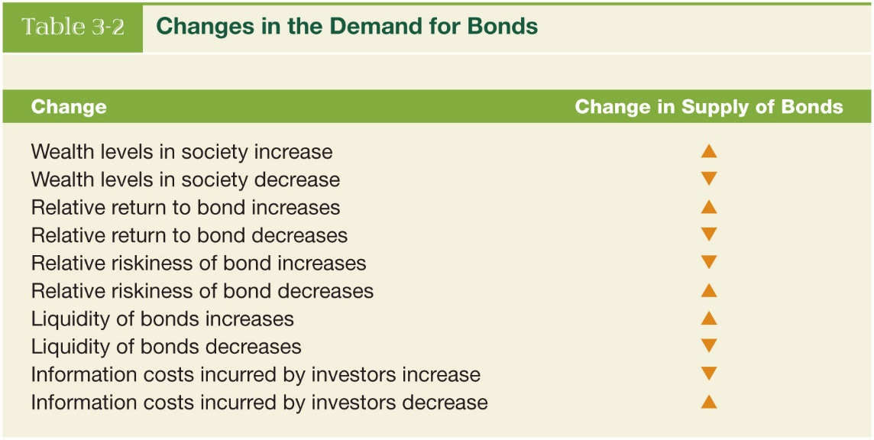
3-3d Changes in the Demand for Bonds
Inverse Relationship between bond prices and yields (interest rate):

Slide 13
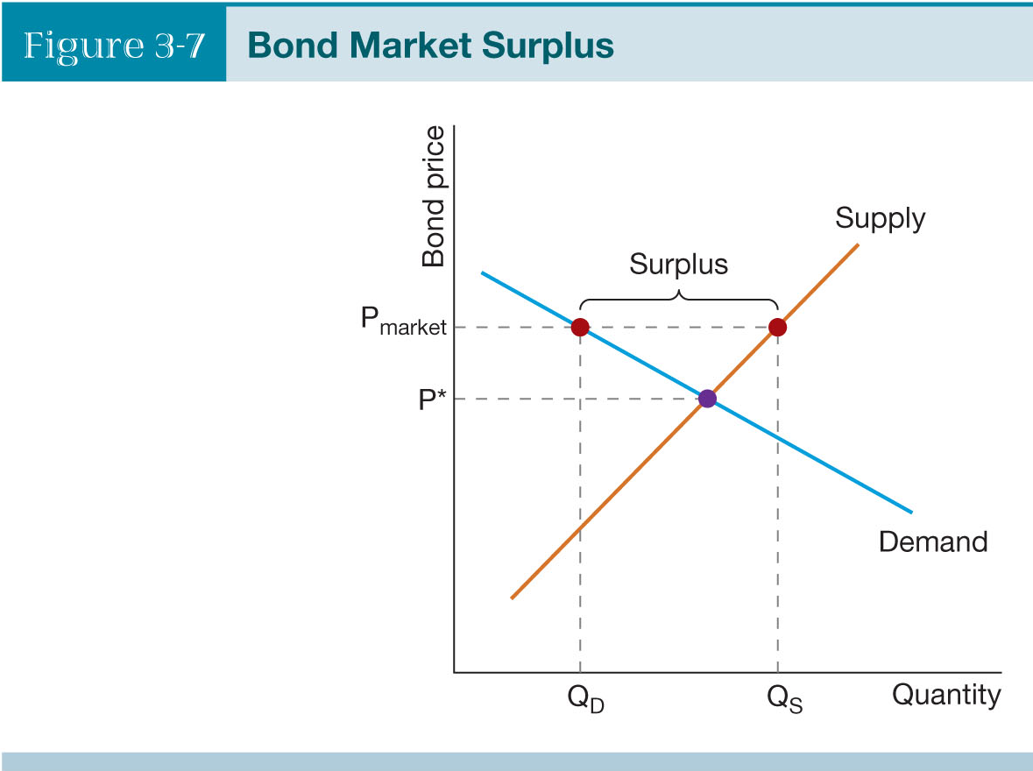
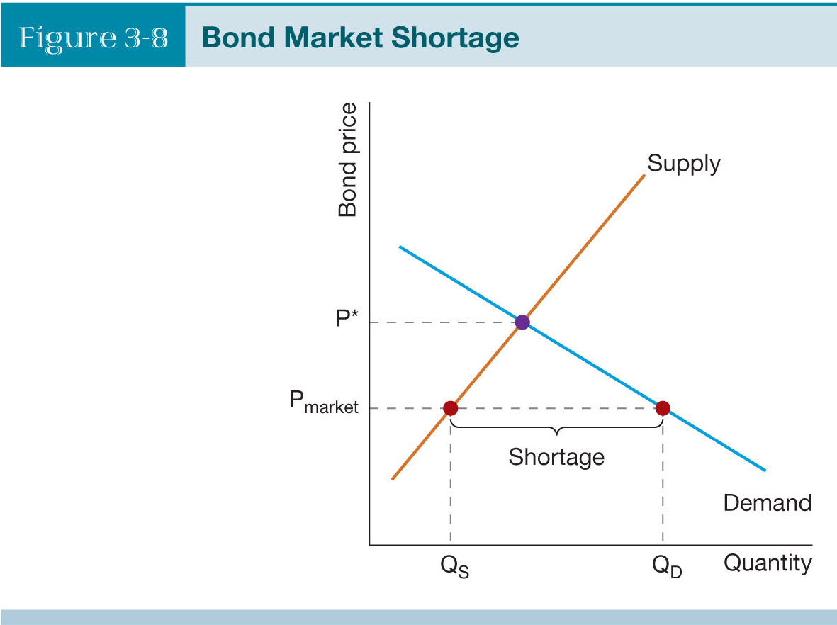
3-3e Equilibrium in the Bond Market
When Quantity Supplied is > Quantity Demanded = Surplus
When Quantity Demanded is > Quantity Supplied = Shortage

Slide 14
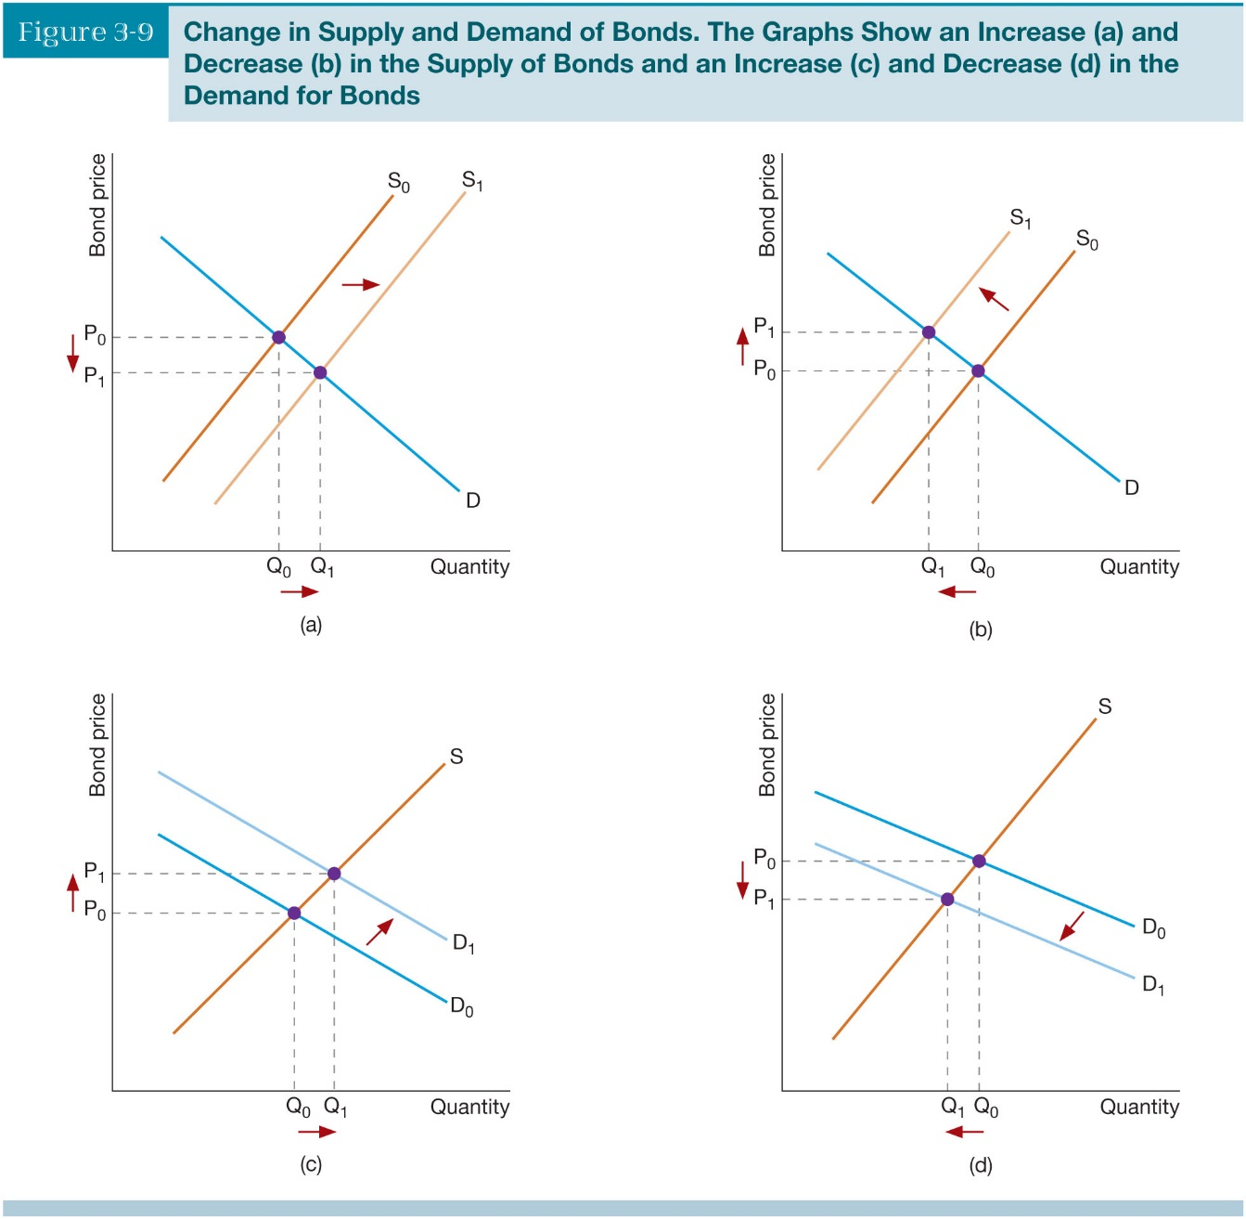
3-3f New Equilibrium in the Bond Market
If the demand for Bonds is falling but at the
same time the supply of bonds is increasing,
The direction of the change in equilibrium
quantity depends on the relative size of the
changes in the supply and demand.
The decrease in demand for bonds is GREATER
than the increase in supply
We can conclude Equilibrium price will fall,
Equilibrium Q supplied will increase

Slide 15
Bond market and Loanable funds market
Bond market can be seen as a type of “loanable fund” market
“Loanable fund” market can be used in a macro context to denote all markets where funds from savers are channeled to borrowers
This can either be:
  “Direct finance” – where lenders know identity of borrowers; or
  “Indirect finance” – where lenders do not know identity of borrowers so that there is a financial “intermediary” in place
  e.g. Bond market is direct finance
  e.g. bank lending is indirect finance
  Q: What kind of finance is done in the stockmarket?

Slide 16
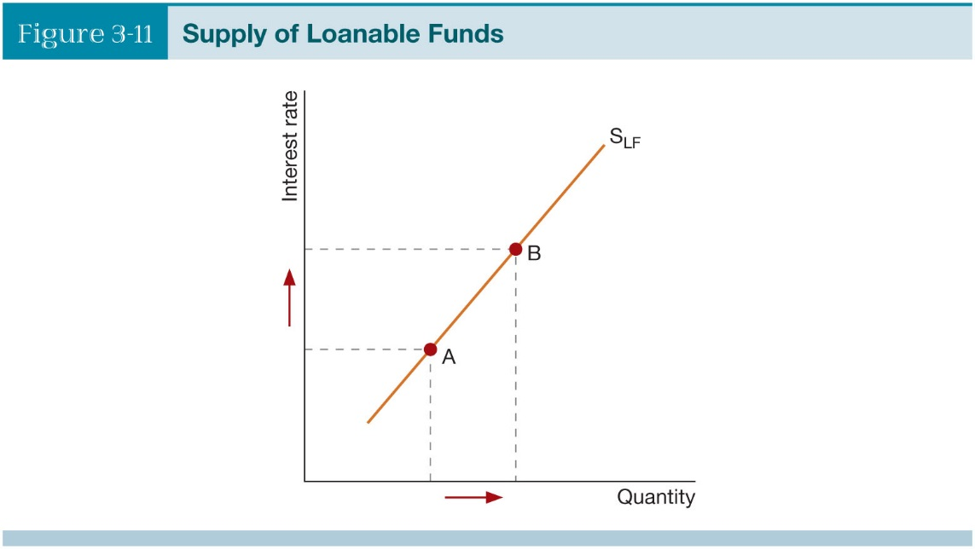
3-4a The Supply of Loanable Funds
The supply curve of loanable funds slopes upward, consider two points, A and B.
As interest rates increase, we observe an
increase in the quantity of loanable funds supplied
Bring more funds to the pool of loanable funds
Households, Firms, Governments, & Rest
of World supply this market

Slide 17
3-4b The Demand for Loanable Funds
Factors that can cause a shift in the demand for loanable funds
  • Household expected income levels
  • Firms’ confidence in the future
  • Amounts of government deficits
  • Rest of the world’s borrowing needs and relative interest rates
  • Expected rate of inflation (future inflation worries increase the demand for loanable funds)

Slide 18
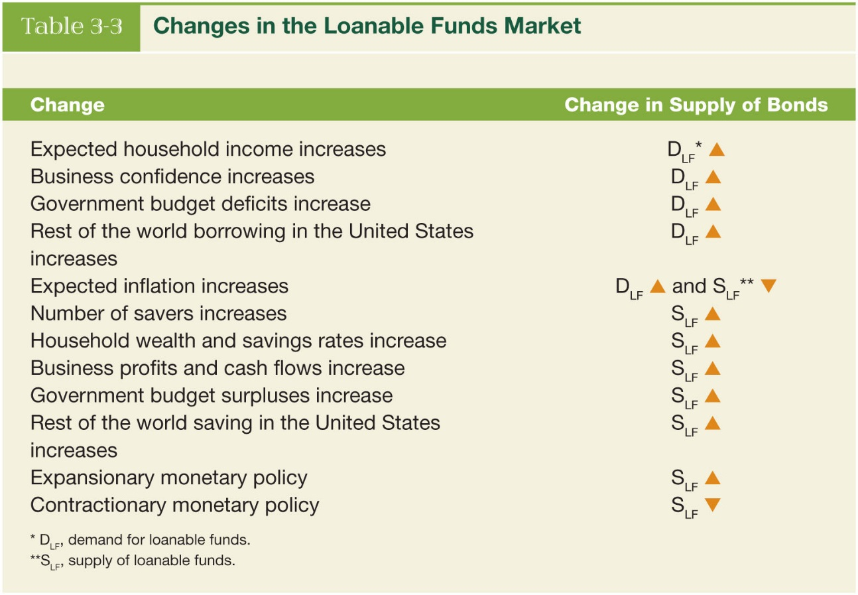
3-4c New Equilibrium in the Loanable Funds Market
The list shown in Table 3.3 provides factors that can and do bring about changes in the supply/or demand for loanable funds.

Slide 19
Fisher effect
Take definition of real interest rate:
  r = i – π^{e}
  i = nominal interest rate
  π^{e} = expected rate of inflation
  So if π^{e} goes up then real cost of borrowing goes down. Therefore bond demand goes down and bond supply goes up
Now rearrange:
  i = r + π^{e} ;
  Assume r stays relatively constant, then:
  An increase in expected inflation should increase nominal interest rates
  This is the “Fisher effect”

Slide 20
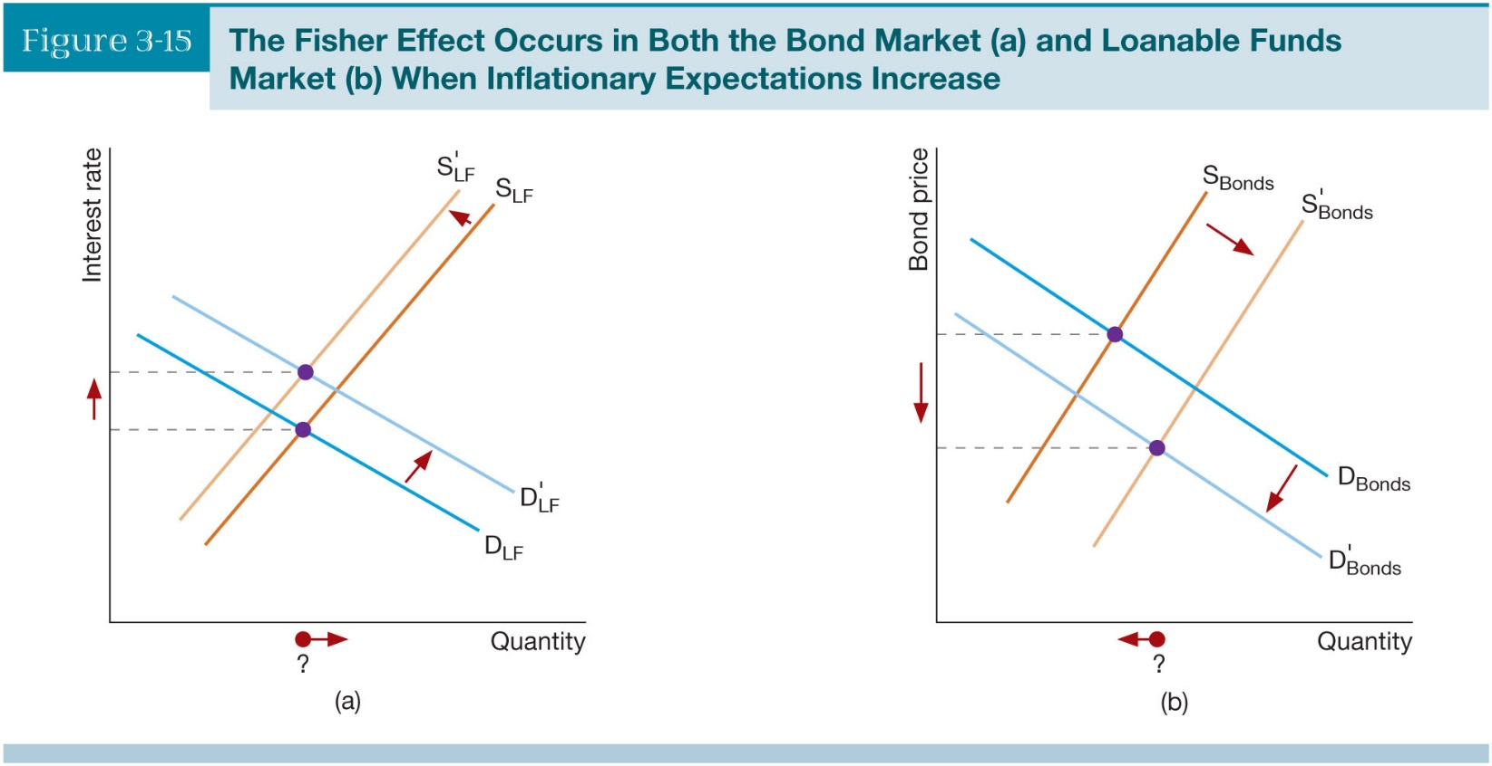
3-5a The Fisher Effect
Occurs in both the loanable funds market as well as the bond market
Both graphs show interest rates increasing due to an increase in inflation

Slide 21
3-5b Business Cycles and Confidence
Interest Rates move along with the economy or business cycle (procyclical)
Business confidence increases, borrowing and spending increase resulting in an expanding economy. When business confidence falls, the opposite occurs
Reduced borrowing leads to a decrease in the demand for loanable funds.
The bond market is therefore a subsector of the loanable funds market.

Slide 22
Summary
Characteristics of bonds
Pricing of bonds
Bond market
Loanable funds theory
Direct vs indirect finance
Fisher effect
Business cycles and loanable funds

