Slide 1

Chapter 2 - Money, Money Supply, and Interest

Slide 2
2-1 The Concept of Money
Just what is money?
Money does, in fact, make the world go around. How?
Why do interest rates exist?
The Value of Money – Value today we will receive in the future vs. the value in the future vs that we have today.

Slide 3
2-1a Money Defined
“Generally accepted” in exchange for goods and services
Russian Ruble Crisis of 1999: people stopped using the official ruble in exchange for goods and services.
Are currencies are considered money all the time? NO

Slide 4
2-1a Money Defined (continued)
Currency substitution – Use of another country’s currency in private transactions.
The local currency remains legal tender and continues to circulate
Legal Tender – Paper money is a valid and legal means of payment of any debt that was contracted in dollars
  the Coinage Act of 1965, specifically Section 31 U.S.C. 5103, entitled "Legal tender," which states: "United States coins and currency (including Federal reserve notes and circulating notes of Federal reserve banks and national banks) are legal tender for all debts, public charges, taxes, and dues.“ No compunction to accept though….
“Official semi-dollarization” – another country’s currency is legal tender, but the country also issues its own currency.

Slide 5
2-1b Functions of Money
Medium of exchange
Medium of Exchange – usable for buying and selling goods and services.
Money allows society to escape the complications of barter.
Money enables society to gain the advantages of geographic and human specialization

Slide 6
Unit of Account
Society uses monetary units – As a yardstick for measuring the relative worth of a wide variety of goods, services and resources.
We gauge the value of goods in dollars
Money aids rational decision making by enabling buyers and sellers to easily compare the prices of various goods, services and resources.

Slide 7
Store of Value
Enables people to transfer purchasing power from the present to the future.
People do not spend all of their income on the day they receive it.
To buy things later, they store some of their wealth as money.
Money does lose its store of value. Inflation reduces the “purchasing power” of money.

Slide 8
Standard of Deferred Payment
Money is used to settle obligations into the future and therefore to write contracts going forward in time
This function holds if the previous 3 properties hold

Slide 9
2-2a Money Supply
The Amount of Money Matters
Inflation occurs due to the money supply grows too quickly.
When the money supply increases too quickly, there is too much money chasing too few goods.
If the money supply does not grow fast enough, there is not enough money for transactions to take place.
Economy could slide into a recession or even worse a depression.

Slide 10
2-2b Characteristics of Money
For any asset to function as money, the following must be met:
  Easily standardized so prices of two units can be compared [“Standardizability”
  Divisible [“Divisibility”]
  Portable [“Portability”]
  Physically durable [“Durability”]
  Recognizable [“Recognizability”]
  Broadly demanded in society

Slide 11
What has functioned as money over time?
Cigarettes:
  Standardized – contained the same amount of quality of tobacco
  Easily divisible – 20 in a pack, “making change” was straightforward
  Portable – easy to carry around
  Long self life, as long as kept dry
  Always in demand
  Nazi POW camps: cigarettes were money

Slide 12
Other Commodity Money
Russian Rouble Crisis of 1999 - people used different forms of commodity money, turned away from using the ruble.
In 1998, 50% to 75% of “exchange in industry” – some type of commodity money, including Russian Vodka
Currency issued by a country’s government has a direct relationship with that country’s function of money.

Slide 13
Challenges with Commodity Money
Two widely used types through time:
  Gold
  Silver
Enough in circulation meets the transaction needs of the people
NOT enough in circulation could slide a country into recession or an economic depression
If the supply increases too rapidly (e.g.due to new discoveries), it triggers inflation (too much money chases too few goods)

Slide 14
Fiat money vs Commodity money
Commodity money – value as money is the same as value as a commodity
Fiat money – value as money is different from value as a commodity
e.g. Gold coin is commodity money if its value as a gold coin is the same as the value of the gold that goes into the coin.
Our currency ( = notes and coins) is fiat money as:
1 cent costs more than one cent to produce (so US mint makes a loss)
$1 note costs less than $1 to produce (so Federal Reserve makes a profit)
Profits and losses from production of money are called “Seigniorage”

Slide 15
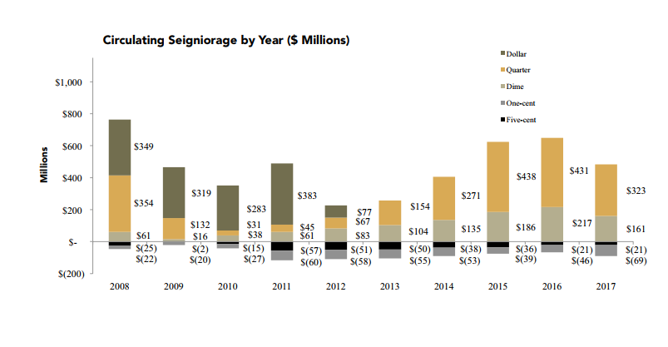
Seigniorage of US mint
Source: https://www.usmint.gov/wordpress/wp-content/uploads/2018/01/2017-annual-report.pdf

Slide 16
Money Definition M1 and money supply M2
M1 – The narrowest definition of the money supply is M1
It consists of two components:
  Currency (coins and paper money) in the hands of the public
  All checkable deposits: all deposits in commercial banks and “ thrift” or savings institutions on which check of any size can be drawn
Money, M1 = currency + checkable deposits

Slide 17
Money Definition M2
M1 + savings deposits, including money market deposit accounts + small – denominated (less than $100,000) time deposits + money market mutual fund held by individuals

Slide 18
2-4a Time Value of Money
Greatly prefer current consumption to future consumption; you have “high time preference”
If you are indifferent between consuming now or in the future, you have a “low time preference”.
Deferring your consumption to the future (something you don’t want to do), I have to compensate you.
The compensation is called interest. The higher your rate of time preference, the higher rate I must pay you to defer your consumption.

Slide 19
2-4b Present Value
Someone lends you $1000.00 for one year. You are asking that person to defer their consumption for one year, so this person will want to be compensated.
$100.00 of interest on the loan, or 10%
Payback at the end of the year = $1,100

Slide 20
2-4b Future Value
Nominal value of an asset, at some point in time in the future.
The concept of time value of money from a saver’s perspective
See example in this section of the book: at the end of 15 years you would have
  $22, 203.66

Slide 21
Compounding vs Discounting
With compounding, you pay someone into the future for deferring consumption now
$1 becomes $1.05 next year if the interest rate is 5%
Then $1x(1+0.05)x(1+0.05) in year 2
If you do the opposite (bring consumption in the future back to the present), you are said to discount.
$1 a year in the future becomes $1/(1+0.05) = $0.952 now

Slide 22
Summary
Definition of Money
Barter
Functions of money
Commodity money
Fiat money
Seigniorage
Money Supply
Monetary Aggregates
Time Value of Money

